Slide 1
Dr. Yifeng Zhu Electrical and Computer Engineering University of Maine
Embedded Systems
Lab 1
Timers and PWM
Fall 2019

Slide 2
Timer
Free-run counter (independent of processor)
Functions
Input capture
Output compare
Pulse-width modulation (PWM) generation
One-pulse mode output

Slide 3

Timer: Clock
Reload Value
ARR
Reload
f_{CL_PSC}
f_{CL_CNT}
Timer
Counter
PSC
ISR
clock
Prescaler
Interrupt
$$f_{CK_CNT}=\frac{f_{CL_PSC}}{PSC+1}$$
Notes:
A timer is a hardware component in ARM Cortex-M microprocessor. Each timer has a special register, which is called the timer counter. The counter runs freely. If enabled, it automatically counts upwards or downwards, under the driven of a clock source. Pay attention. It is hardware, not software, which keeps repeatedly incrementing or decrementing the counter value. For each rising edge in the clock signal, the value of the counter increments or decrements by one automatically. That is why, we say the counter of a timer, is the free-running counter.
By updating the PSC register, we set the timer to be clocked at the rate we desire. The PSC register holds the frequency pre-scaler value, or the frequency divider. The frequency of the clock source is divided by a constant integer, PSC plus 1, before the input clock is fed to the counter. The prescaler enables a tradeoff between timer resolution and timer range. High timer resolution requires a high clock rate. However, high clock rates cause the timer to overflow or underflow more quickly.

Slide 4
Timer: Output
Reload Value
ARR
Reload
f_{CL_PSC}
f_{CL_CNT}
Timer
Counter
PSC
ISR
clock
Prescaler
Interrupt
=
Timer Output
(OCREF)
Compare & Capture Register (CCR)
Notes:
When a timer is configured to generate an output signal, hardware constantly compares the freely-running counter, with a value stored in the compare and capture register (CCR). The output of the timer, OCREF, can be high or low, depending on the timer settings. Note that, when the function of a timer is output, the CCR register is used only for compare.

Slide 5
Timer: Input Capture
Reload Value
ARR
Reload
f_{CL_PSC}
f_{CL_CNT}
Timer
Counter
PSC
ISR
clock
Prescaler
Interrupt
Compare & Capture Register (CCR)
Notes:
A timer can also be used for input capture. When a specific external event occurs, such as a rising edge of an external signal on a G P I O pin, hardware automatically copies, the current value of the timer counter, to the compare and capture register (CCR). We can use such an ability to measure the timing information of a signal event, such as rising edge, or falling edge. By calculating the difference between two recorded CCR values, we can measure the period, or the pulse width of input signals. In this lecture, I will focus only on the output function, instead of the input capture. Specifically, I will show how to program the timer to generate a PWM signal.

Slide 6
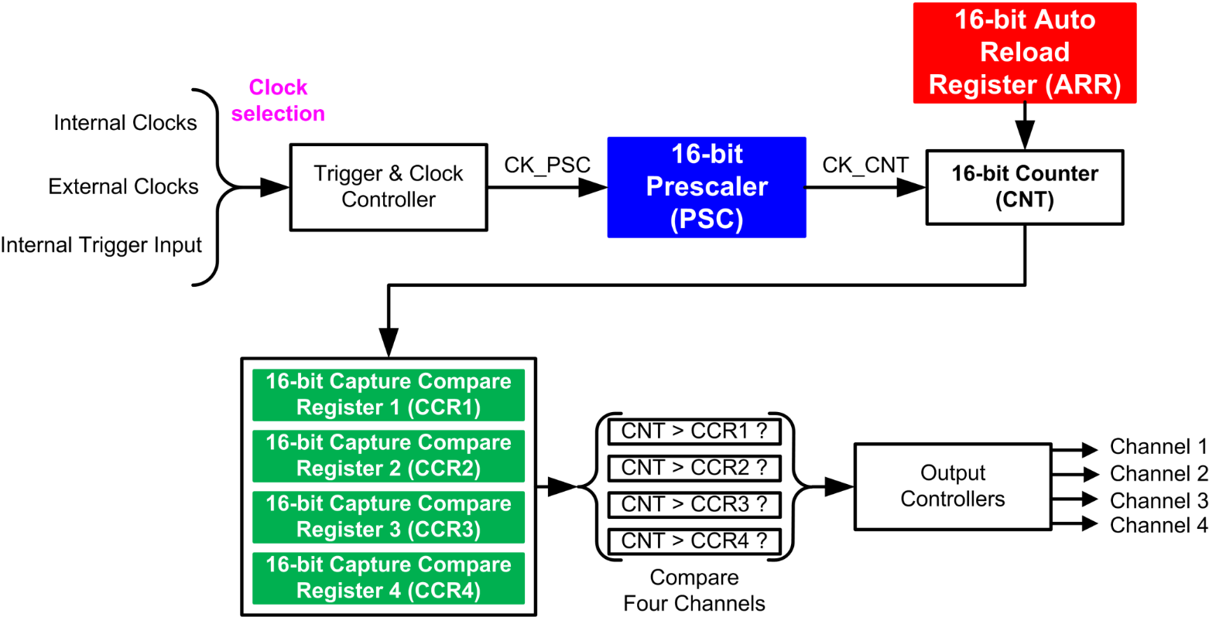
Multi-Channel Outputs
Notes:
{{Pause=2}} Typically, a single timer can generate, up to 4 PWM signals, with independent duty cycles, and identical frequency. Each timer has four channels. Each channel has its own Compare and Capture Register. CCR1, CCR2, CCR3, CCR4. These four channels share the timer counter, and the auto-reload register (ARR). Therefore, these PWM outputs have exactly the same period. However, their duty cycle can be different, because the value of these CCR registers can differ from each other.

Slide 7
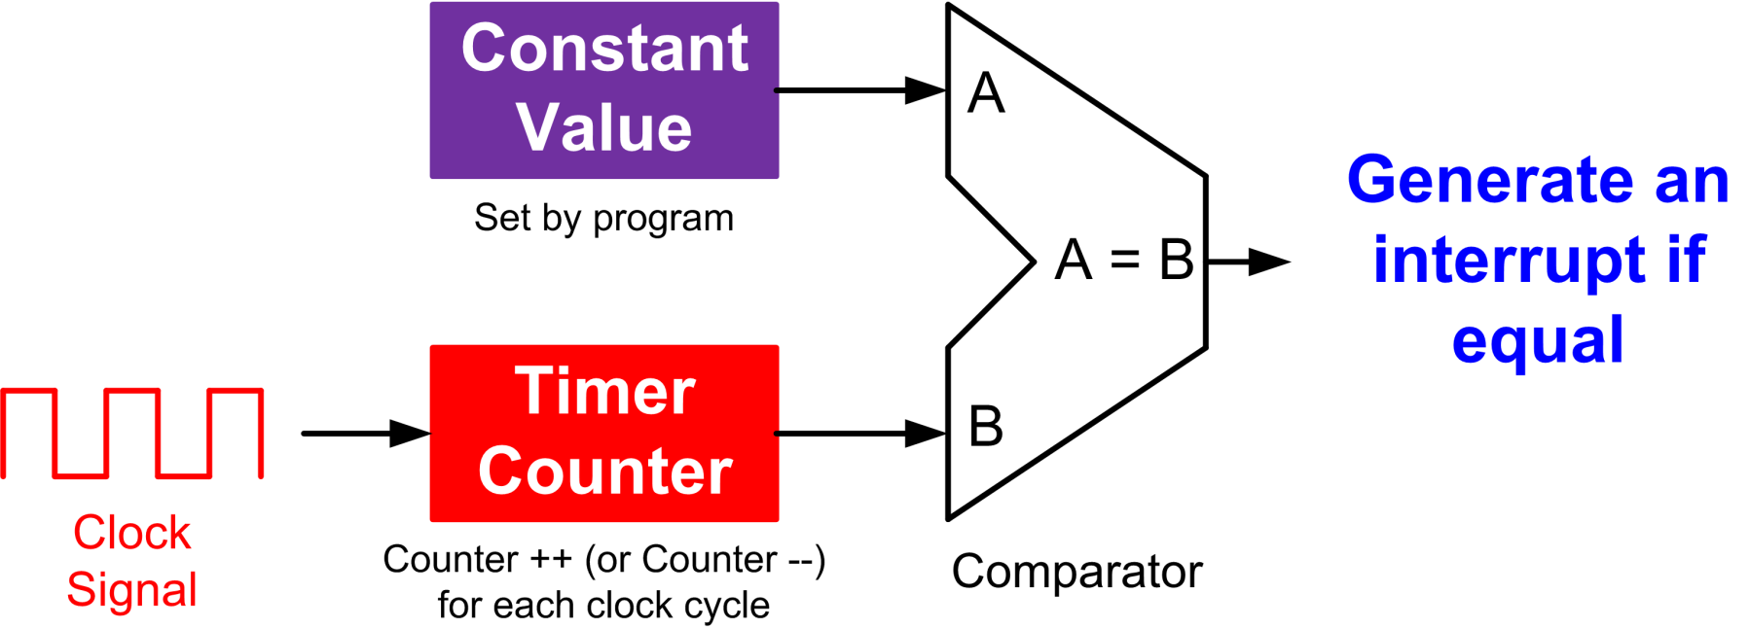
Output Compare
Output Compare Mode (OCM) | Timer Output (OCREF)
000 | Frozen
001 | High if CNT == CCR
010 | Low if CNT == CCR
011 | Toggle if CNT == CCR
100 | Forced low (always low)
101 | Forced high (always high)

Slide 8
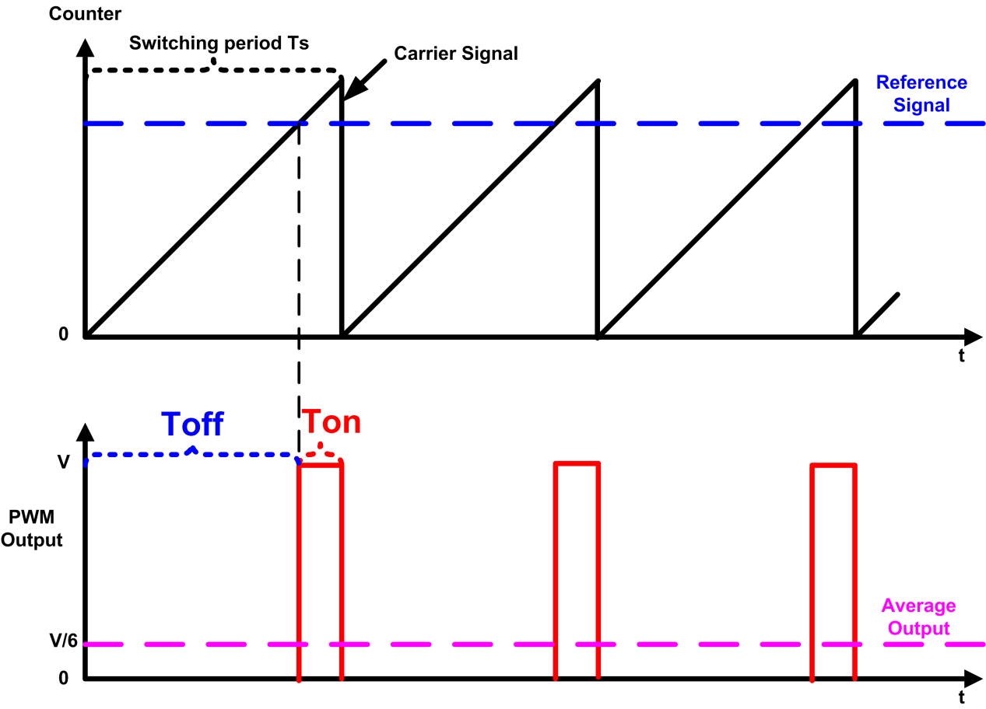
PWM Mode
Mode | Counter < Reference | Counter ≥ Reference
PWM mode 1 (Low True) | Active | Inactive
PWM mode 2 (High True) | Inactive | Active

Slide 9
Edge-aligned Mode (Up-counting)
ARR = 6, RCR = 0
clock
6
6
6
6
5
Counter overflow
5
Counter overflow
5
Counter overflow
5
4
4
4
4
counter
3
3
3
3
2
2
2
2
1
1
1
1
0
0
0
0
Counter overflow
Update event (UEV)
Period = (1 + ARR) * Clock Period
= 7 * Clock Period
Notes:
We can configure the timer to repeatedly count up, count down, or, count up and down. Let’s first take a look at the up-counting mode. The auto-reload register (ARR) holds the maximum counter value, which is also called the auto-reload value. The counter counts from 0 to the auto-reload value, then restarts from 0, and generates a counter overflow event. This figure shows an example of the counter behavior when ARR is 6, and the repetition counter is not used. In the up-counting mode, the counter rolls over and is reset when it exceeds 6. When the counter resets, it triggers a counter overflow and an update event (UEV). After that, a new period starts. The counting period is determined by the auto-reload value, as well as the clock period.

Slide 10
Edge-aligned Mode (down-counting)
ARR = 6, RCR = 0
Clock
6
6
6
6
5
5
5
5
4
4
4
4
Counter
3
3
3
3
2
Counter underflow
2
Counter underflow
2
Counter underflow
2
1
1
1
1
0
0
0
0
Counter underflow
Update event (UEV)
Period = (1 + ARR) * Clock Period
= 7 * Clock Period
Notes:
In the down-counting mode, the counter counts from the auto-reloaded value down to 0. After the counter has reached 0, hardware automatically reloads the counter with the auto-reloaded value, and generate a counter underflow event and an update event (UEV). The counting period of the down-counting mode is exactly the same as the counting period of the up-counting mode.

Slide 11
Center-aligned Mode
ARR = 6, RCR = 0
Clock
6
6
5
5
5
5
4
4
4
4
Counter
3
3
3
3
2
2
2
2
1
1
1
1
0
0
0
Counter overflow
Counter underflow
Counter overflow
Counter underflow
Update event (UEV)
Period = 2 * ARR * Clock Period
= 12 * Clock Period
Notes:
In center-aligned mode, the counter counts from 0 to the auto-reload value minus 1, generates a counter overflow event, then counts from the auto-reload value down to 1 and generates a counter underflow event. Then it restarts counting
from 0. In this mode, the counting direction changes automatically on counter overflow and underflow.

Slide 12
PWM Mode 1 (Low-True)
Mode 1
High if counter < CCR
Timer Output =
Low if counter ≥ CCR
Upcounting mode, ARR = 6, CCR = 3, RCR = 0
Clock
6
6
6
6
5
5
5
5
CCR = 3
4
4
4
4
Counter
3
3
3
3
2
2
2
2
1
1
1
1
0
0
0
0
OCREF
CCR
Duty Cycle =
Period = (1 + ARR) * Clock Period
= 7 * Clock Period
ARR + 1
3
=
7
Notes:
A single timer can generate up to 4 PWM signals with independent duty cycles and identical frequency. When multiple PWM signals are generated by the same timer, all rising edges occur at the same time. That is why it is called edge-aligned.

Slide 13
PWM Mode 2 (High-True)
Mode 2
Low if counter < CCR
Timer Output =
High if counter ≥ CCR
Upcounting mode, ARR = 6, CCR = 3, RCR = 0
Clock
6
6
6
6
5
5
5
5
CCR = 3
4
4
4
4
Counter
3
3
3
3
2
2
2
2
1
1
1
1
0
0
0
0
OCREF
CCR
Duty Cycle = 1 -
Period = (1 + ARR) * Clock Period
= 7 * Clock Period
ARR + 1
4
=
7

Slide 14
PWM Mode 2 (High-True)
Mode 2
Low if counter < CCR
Timer Output =
High if counter ≥ CCR
Upcounting mode, ARR = 6, CCR = 3, RCR = 0
Clock
CCR = 5
6
6
6
6
5
5
5
5
4
4
4
4
Counter
3
3
3
3
2
2
2
2
1
1
1
1
0
0
0
0
OCREF
CCR
Duty Cycle = 1 -
Period = (1 + ARR) * Clock Period
= 7 * Clock Period
ARR + 1
2
=
7

Slide 15
PWM Mode 2 (High-True)
Mode 2
Low if counter < CCR
Timer Output =
High if counter ≥ CCR
Center-aligned mode, ARR = 6, CCR = 3, RCR = 0
Clock
6
6
5
5
5
5
CCR = 3
4
4
4
4
Counter
3
3
3
3
2
2
2
2
1
1
1
1
0
0
0
OCREF
CCR
Duty Cycle = 1 -
Period = 2 * ARR * Clock Period
= 12 * Clock Period
ARR
1
=
2

Slide 16
PWM Mode 2 (High-True)
Mode 2
Low if counter < CCR
Timer Output =
High if counter ≥ CCR
Center-aligned mode, ARR = 6, CCR = 3, RCR = 0
Clock
6
6
5
5
5
5
4
4
4
4
Counter
3
3
3
3
2
2
2
2
CCR = 1
1
1
1
1
0
0
0
OCREF
CCR
Duty Cycle = 1 -
Period = 2 * ARR * Clock Period
= 12 * Clock Period
ARR
5
=
6

Slide 17
Auto-Reload Register (ARR)
Auto-Reload Preload Enable (ARPE) bit in TIMx_CR1
ARPE = 1 (Syn Update)
Write to ARR
Preload Register
Auto-reload Register (ARR)
Read from ARR
If UDIS bit in TIMx_CR1 is 1, UEV event is disabled.
Triggered by Update Event (UEV)
ARPE = 0 (Asyn Update)
Write to ARR
Auto-reload Register (ARR)
Read from ARR
Notes:
{{Pause=2}} The auto-reload register (ARR) can be updated synchronously, or asynchronously. If the A R P E bit in the timer CR1 register is 1, ARR will be updated synchronously. An update to ARR will be buffered in a register, named the pre load register. The contents of the pre load register, are transferred into ARR, when the next update event occurs. This update mechanism is synchronous to timer’s input clock, and timer’s output period. It prevents software from updating the output frequency or period, when the timer is still performing comparison operations. {{Pause=1}} On the other hand, if the auto-reload {{Pause=0.1}} pre load enable bit (A R P E), is 0, any updates to ARR will immediately take effect. This update mechanism is asynchronous, because the update does not take the clock timing information into considerations.

Slide 18
Repetition Counter Register (PCR)
Notes:
The update event (UEV) is generated with respect to the counter overflows and underflows. In fact, update events are only generated when the repletion counter has reached zero. When the repetition counter register (PCR) is zero, an update event is generated with respect to each overflow or underflow.

Slide 19
Repetition Counter Register (PCR)
Notes:
When the repetition counter register (PCR) is one, in Center aligned mode, the update event occurs either on the overflow or on the underflow depending on, when the RCR register was written, and when the counter was launched. If the RCR was written before launching the counter, the UEV occurs on the overflow. If the RCR was written after launching the counter, the UEV occurs on the underflow. In the upcounting mode, an UEV event is generated with respect to every other overflow. Similarly, an UEV event is generated every other underflow in the down-counting mode.

Slide 20
Repetition Counter Register (PCR)
Notes:
This shows the generation of UEV events when the repetition counter register (PCR) is two.

Slide 21
Repetition Counter Register (PCR)
Notes:
These are the UEV events when the repetition counter register (PCR) is three. An UEV is generated each 4th overflow or underflow event depending on when the RCR was written.

Slide 22
Repetition Counter Register (PCR)

Slide 23

PWM Output Polarity
Mode | Counter < CCR | Counter ≥ CCR
PWM mode 1 (Low True) | Active | Inactive
PWM mode 2 (High True) | Inactive | Active
Output Polarity:
Software can program the CCxP bit in the TIMx_CCER register
 | Active | Inactive
Active High | High Voltage | Low Voltage
Active Low | Low Voltage | High Voltage
Notes:
{{Pause=2}} Software can program the polarity of PWM signals. Each timer has two PWM modes, mode 1 and mode 2. These two modes are complementary to each other. However, software can select the output polarity by writing the CCxP bit in the C C E R register. {{Pause=1}} Software can select either active high or active low. If it is active high, the output is high voltage for the active state, and low voltage for the inactive state. {{Pause=1}} On the other hand, for active low, the output is low voltage for the active state, and high voltage for the inactive state.

Slide 24
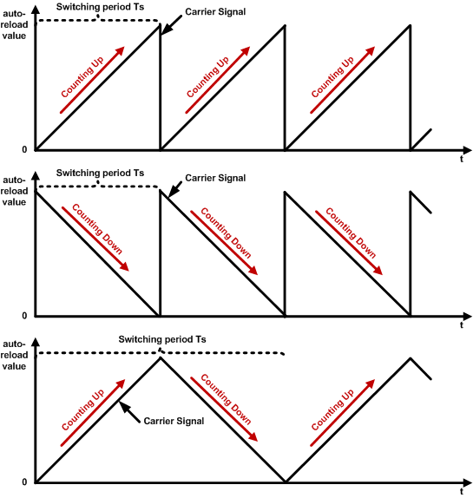
Counting up, down, center

Slide 25
Up-Counting: Left Edge-aligned
Upcounting mode, ARR = 6, CCR = 3, RCR = 0
Clock
CCR = 6
5
6
5
6
5
6
5
6
CCR = 3
3
4
3
4
3
4
3
4
Counter
2
2
2
2
0
1
0
1
0
1
0
1
CCR = 3
OC1REF
CCR = 6
OC2REF
Left-aligned
All rising edges occur at the same time!
PWM Period
Notes:
{{Pause=2}} In the up-counting mode, when multiple PWM signals are generated by the same timer, all rising edges occur at the same time. {{Pause=1}} That is why the up-counting mode is edge-aligned. This example shows the PWM output when CCR is 3 and 6. All rising edges of the PWM signals are aligned with the overflow events of the timer counter. {{Pause=1}} More specifically, the PWM outputs are left edge aligned, because all pulses are aligned to the left side of the PWM period. The outputs go to their active state at the beginning of the period, {{Pause=0.5}} stay on, for an amount of time determined by their duty cycle, {{Pause=0.5}} then turn off for the remainder of the period. After that, this process repeats. {{Pause=0.5}} In summary, If a timer is configured to count up, its PWM signals are edge-aligned, and more specifically, left-aligned.

Slide 26
PWM Mode 2: Right Edge-aligned
Upcounting mode, ARR = 6, CCR = 3, RCR = 0
Clock
CCR = 5
5
6
5
6
5
6
5
6
CCR = 3
3
4
3
4
3
4
3
4
Counter
2
2
2
2
0
1
0
1
0
1
0
1
OC1REF
CCR = 3
OC2REF
CCR = 5
All falling edges occur at the same time!
Right-aligned
PWM Period
Notes:
{{Pause=2}} When multiple PWM signals are generated by the same timer in mode 2, all falling edges occur at the same time. That is why mode 2 is edge-aligned. This example shows the PWM output when CCR is 3, and 5. {{Pause=1}} All falling edges of the PWM signals are aligned with the overflow events. {{Pause=1.5}} More specifically, the PWM outputs are right edge aligned, because all pulses are aligned to the right side of the PWM period.

Slide 27
PWM Mode 2: Center Aligned
Low if counter < CCR
Timer Output =
High if counter ≥ CCR
Center-aligned mode, ARR = 6, CCR = 3, RCR = 0
Clock
5
6
5
5
6
5
CCR = 3
3
4
3
4
3
4
3
4
Counter
2
2
2
2
CCR = 1
0
1
0
1
1
0
1
OC1REF
CCR = 3
CCR = 1
OC2REF
PWM signals are center aligned!
Center-aligned
PWM Period
Notes:
{{Pause=2}} When a timer generates multiple PWM signals, the centers of the PWM pulses are aligned with, the peak value of the timer counter. In other words, the active pulse of, all output channels, are placed at the center of each PWM period. {{Pause=2}} Center-aligned PWM signals are often used in electronic circuits, such as motor control and power supplies. The signals are symmetrical and thus have less harmonics. It helps reduce noise interference and power consumption.

Slide 28
The devil is in the detail
Timer output control
Enable Timer Output
MOE: Main output enable
OSSI: Off-state selection for Idle mode
OSSR: Off-state selection for Run mode
CCxE: Enable of capture/compare output for channel x
CCxNE: Enable of capture/compare complementary output for channel x
Notes:
{{Pause=2}} The output of a timer is enabled by a combination of the following control bits: M O E (Main output enable bit), O S S I (Off-state selection for Idle mode), O S S R (Off-state selection for Run mode), C C x E (Enable of capture/compare output for channel x), and, C C x N E (Enable of capture/compare complementary output for channel x). {{Pause=0.5}} These control bits are located in the timer register C C E R, and register B D T R. {{Pause=1}} For example, in order to enable the output (O C) for channel x, we need to set the M O E bit to 1 in register B D T R. {{Pause=1}} Based on the need of software application, we can choose one of these three configurations.

Slide 29
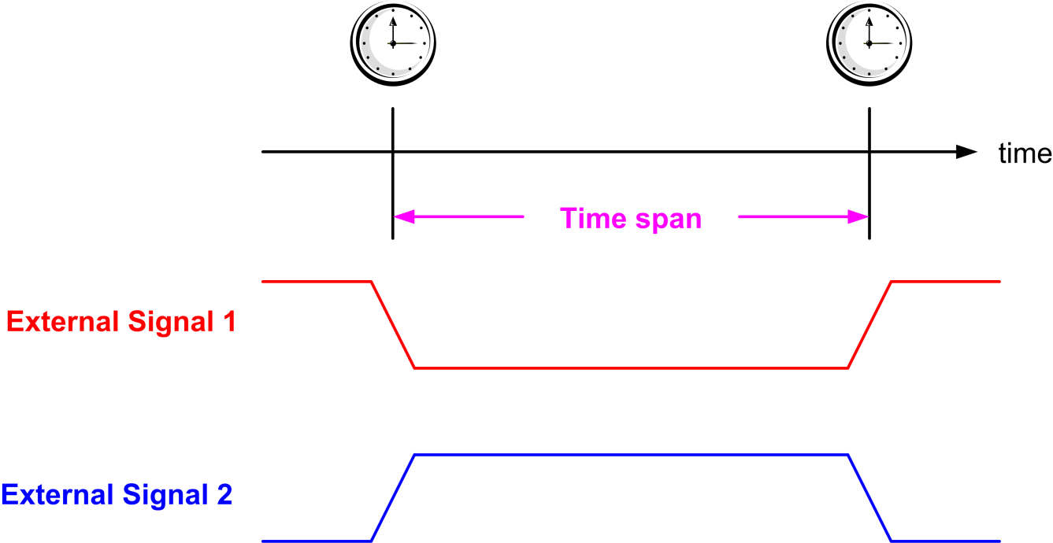
Input Capture
Monitor both rising and falling edge

Slide 30
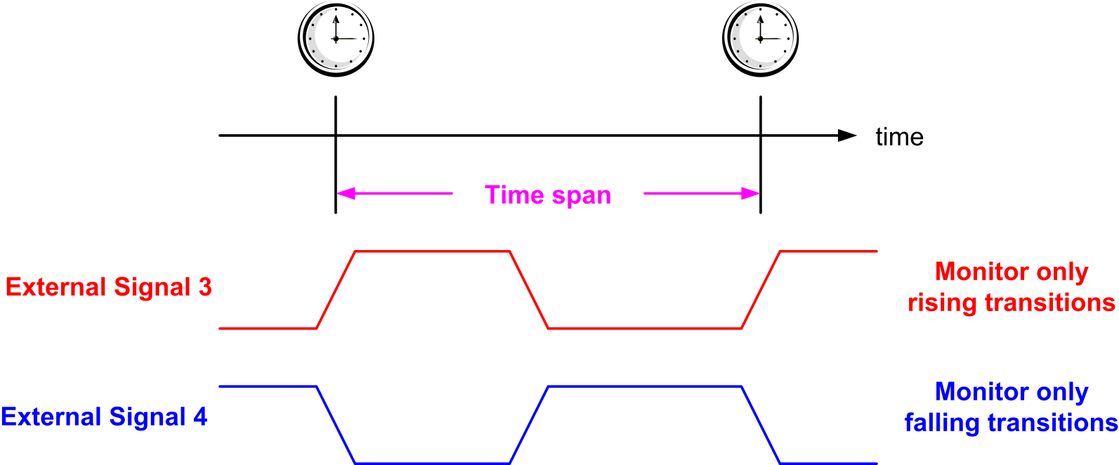
Input Capture
Monitor only rising edges or only falling edge

Slide 31
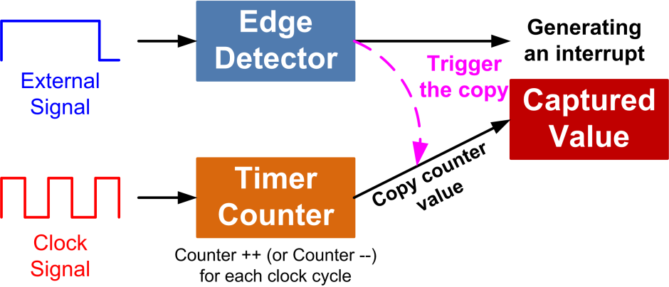
Input Capture

Slide 32
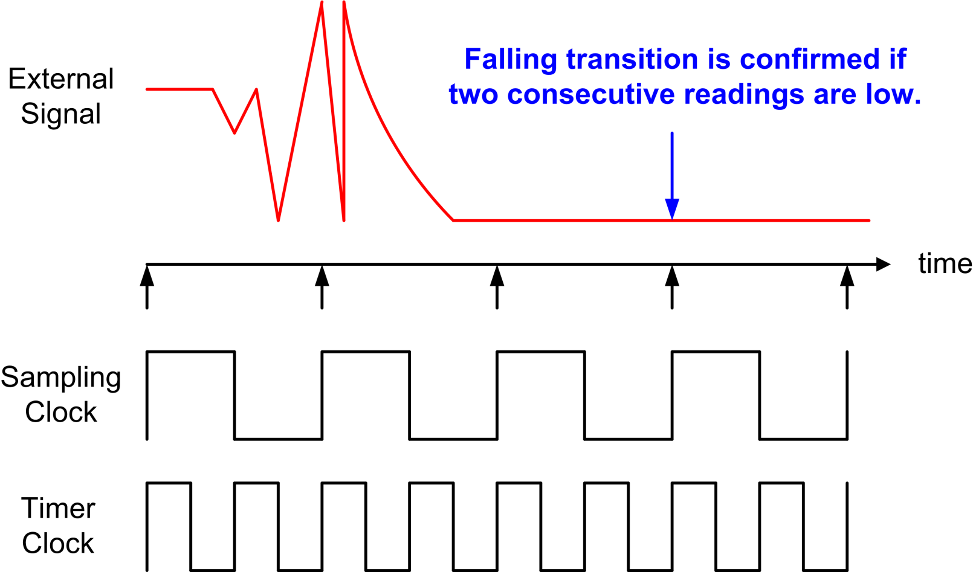
Input Filtering

Slide 33
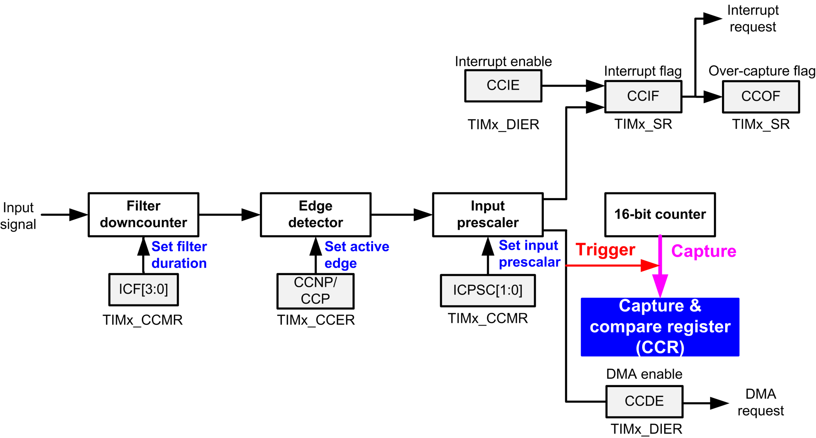
Input Capture Diagram

Slide 34
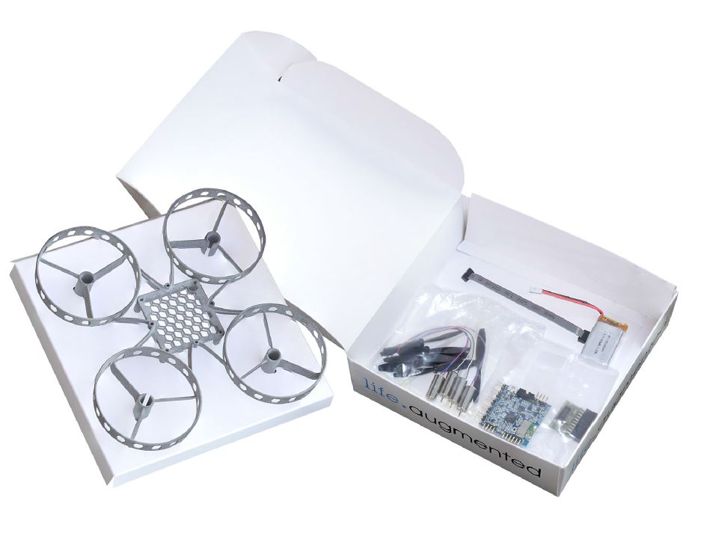
Intro to the STEVAL Drone Kit:
The STEVAL-DRONE01 is a drone kit with fully functional open source code libraries

Slide 35
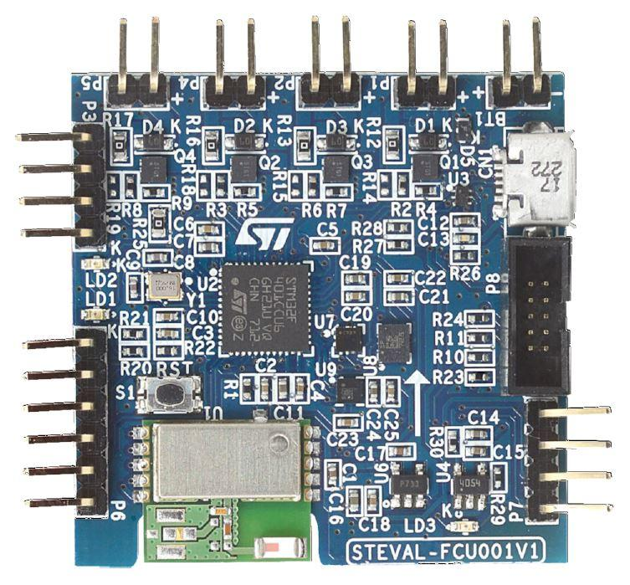
The STEVAL Development Board
The drone uses the STEVAL-FCU001V1 development board, optimized for drone design

Slide 36
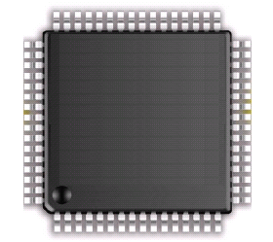
General Purpose Input/Output (GPIO)
D Bus
FLASH
ARM Cortex-M4
FPU
I Bus
AHB Bus Matrix
SRAM
S Bus
GPIO A
GPIO B
APB Bus Matrix
GPIO C
GPIO D
GPIO E
UART
GPIO F
GPIO G
SPI
GPIO H
Timer
…
STM32L4
Notes:
{{Pause=2}} The ARM Cortex-M4 processor core, is connected to the other components via three buses, include the data bus, the instruction bus, and the system bus. These buses are connected to the Advanced high performance bus (AHB) matrix. AHB is the backbone bus. It is used for high-performance, high clock frequency system modules, such as on-chip flash, on-chip SRAM, as well as G P I O modules. The chip also has a bridge that connects AHB to Advanced Peripheral Bus (APB). APB is for low bandwidth peripherals. APB connects most of the peripheral devices in the system, such as UART, S P I, and timer.
{{Pause=1}} Here is the basic structure of a G P I O module. I will explain the details of this module in the next slide.

Slide 37
General Purpose Input/Output (GPIO)
D Bus
FLASH
ARM Cortex-M4
FPU
I Bus
AHB Bus Matrix
SRAM
S Bus
GPIO A
GPIO B
APB Bus Matrix
GPIO C
GPIO D
GPIO E
UART
GPIO F
GPIO G
SPI
GPIO H
Timer
…
STM32L4
Notes:
{{Pause=2}} The ARM Cortex-M4 processor core, is connected to the other components via three buses, include the data bus, the instruction bus, and the system bus. These buses are connected to the Advanced high performance bus (AHB) matrix. AHB is the backbone bus. It is used for high-performance, high clock frequency system modules, such as on-chip flash, on-chip SRAM, as well as G P I O modules. The chip also has a bridge that connects AHB to Advanced Peripheral Bus (APB). APB is for low bandwidth peripherals. APB connects most of the peripheral devices in the system, such as UART, S P I, and timer.
{{Pause=1}} Here is the basic structure of a G P I O module. I will explain the details of this module in the next slide.

Slide 38
Basic Structure of an I/O Port Bit Input and Output
Schmitt
trigger
Notes:
{{Pause=2}} Most G P I O ports have 16 pins. This diagram shows the standard structure of one G P I O pin. It includes the basic structure for both digital input, and digital output. In this lecture, I will only focus on the digital output part. We will discuss the digital input in a separate lecture.

Slide 39
Basic Structure of an I/O Port Bit: Output
GPIO Pull-up/Pull-down Register (PUPDR)
00 = No pull-up, pull-down 01 = Pull-up
10 = Pull-down 11 = Reserved
Output Data Register
Schmitt
trigger
GPIO Output Type Register (OTYPER)
0 = Output push-pull (default)
1 = Output open-drain
GPIO MODE Register
00 = Input, 01 = Output,
10 = AF, 11 = Analog (default)
Notes:
{{Pause=2}} Here is the basic structure, that is designed for digital output, on one G P I O pin. There are four important registers related to output, including the output data register, {{Pause=1}} the mode register, {{Pause=1}} the data output type register, {{Pause=1}} and the pull-up pull-down register. In this slide, I only give a short overview of each registers. Detailed discussion will be presented in the next few slides. {{Pause=1}} We can use the mode register to configure the pin as output. {{Pause=1}} The output type register, sets the output pin as, either push-pull or open-drain. {{Pause=1}} The pull-up pull down register, specifies, whether the pin is pulled up to a high voltage by a resister, or the pin is pulled down to the ground via another resister.
{{Pause=1}} When the pin is configured as output, the value written to the output data register is output on the G P I O pin. {{Pause=1}} However, whether the pin has a high voltage output, a low voltage output, or a high impedance output, depends on the configuration of the output type register, and the pull-up pull-down register.

Slide 40
Enable Clock
AHB2 peripheral clock enable register (RCC_AHB2ENR)
SYSCLK
Clock for Port B
1
GPIOEN
AND Gate
#define RCC_AHB2ENR_GPIOBEN ((uint32_t)0x00000002U)
RCC->AHB2ENR |= RCC_AHB2ENR_GPIOBEN;
Notes:
{{Pause=2}} To improve energy-efficiency, the clock of most peripherals, is turned off. As presented previously, the red LED is connected to the pin 2 of port B. {{Pause=1}} First of all, we need to enable the clock of G P I O Port B. The clock can be turned on or off by configuring the reset and clock control module (RCC). Specifically, the clock of port B is controlled by the AHB2, peripheral clock enable register (A H B 2 E N R). We need to set bit 1, that is, G P I O B Enable Bit, of this register to 1. When G P I O B Enable bit is 1, the clock signal can pass through this logic {{Pause=0.1}} AND gate to drive the port B. On the other hand, if G P I O B Enable it is zero, the output of the logic {{Pause=0.1}} AND gate is always zero. Accordingly, the port B has no clock input.
{{Pause=1}} Software can set G P I O B Enable bit to 1 by using bitwise OR. In order to make the code more readable, we use this macro to define this constant. In fact, this macro has already been defined in the device header file.

Slide 41
GPIO Mode Register (MODER)
32 bits (16 pins, 2 bits per pin)
Pin 2
Pin 1
Pin 0
GPIOB->MODER &= ~(3UL<<4); // Clear bits 4 and 5 for Pin 2
GPIOB->MODER |= 1UL<<4; // Set bit 4, set Pin 2 as output
Notes:
{{Pause=2}} Software can program each {{Pause=0.1}} G P I O pin as one of the following four different functions. First, digital input, which detects, whether an external voltage signal, is higher or lower than a predetermined threshold. Second, digital output, which controls the voltage on the pin. Third, analog functions, which perform digital-to-analog, or analog-to-digital conversion. Last, other complex functions, such as S P I data pin, and timer PWM output. We call the last category of functions as alternative functions. {{Pause=1}}
The function of a pin is controlled by the MODE register of this port. Each mode register has 32 bits. Port B has a total of 16 pins. The function of each pin is determined by two bits of the mode register. For example, bit 5 and bit 4 control the function of pin 2. When these two bits are zero zero, the pin is set as digital input. When these bits are zero one, this pin is used for digital output. When they are one zero, the pin has alternative function. Specific alternative function will be determined by the alternative function register of this port. When these two bits are one one, the pin will be used for analog-to-digital conversion (ADC), or digital-to-analog conversion (DAC). {{Pause=1}}
In this example, pin PB 2 will be used as output to turn on the red LED. Therefore, we need to set bit 5 and bit 4 to zero and one, respectively. {{Pause=2}} Here is the C code. First, we clear bit 4 and 5. Then we set bit 4 by using bitwise OR.

Slide 42
GPIO Output Type Register (OTYPE)
16 bits reserved, 16 data bits, 1 bit for each pin
GPIOB->OTYPE &= ~(1UL<<2); // Clear bit 2
Notes:
{{Pause=2}} Next, we need to set the output of mode of Pin 2 as push-pull, instead of open drain. Therefore, software has to clear bit 2 of the output type register. In the following few slides, I will explain what is the difference between push pull, and open drain.

Slide 43
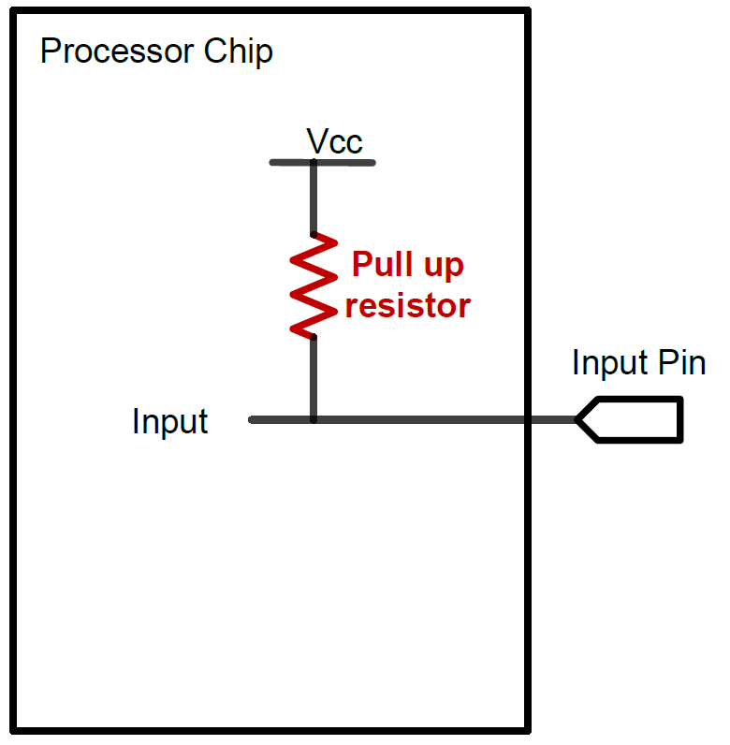
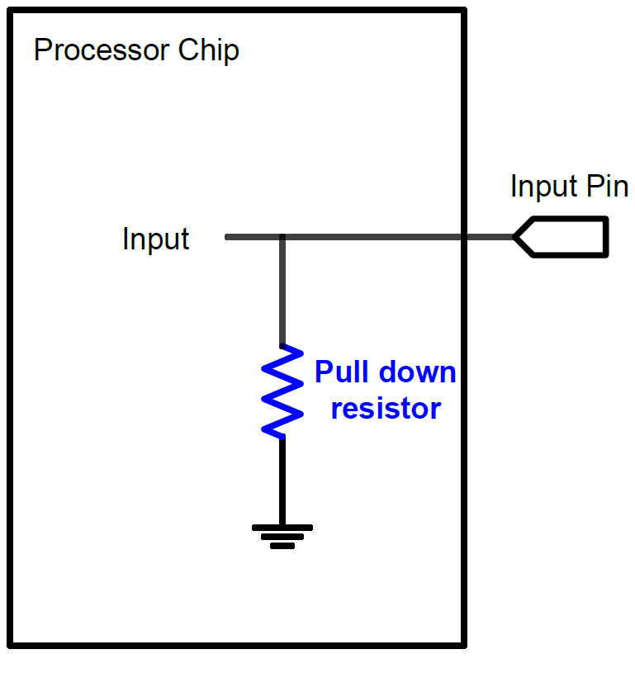
GPIO Input: Pull Up and Pull Down
A digital input can have three states: High, Low, and High-Impedance (also called floating, tri-stated, HiZ)
Pull-Up
Pull-Down
If external input is HiZ, the input is read as a valid HIGH.
If external input is HiZ, the input is read as a valid LOW.

Slide 44
GPIO Output: Push-Pull
GPIO Output = 1
Source current to external circuit

Slide 45
GPIO Output: Push-Pull
GPIO Output = 0
Drain current from external circuit

Slide 46
GPIO Output: Open-Drain
GPIO Output = 0
Drain current from external circuit

Slide 47
GPIO Output: Open-Drain
Output = 1
GPIO Pin has high-impedance to external circuit

Slide 48
GPIO Output Speed
Output Speed:
Speed of rising and falling
Four speeds: Low, Medium, Fast, High
Tradeoff
Higher GPIO speed increases EMI noise and power consumption
Configure based on peripheral speed
Low speed for toggling LEDs
High speed for SPI
Speed of Rising
Low
Medium
Fast
High

Slide 49
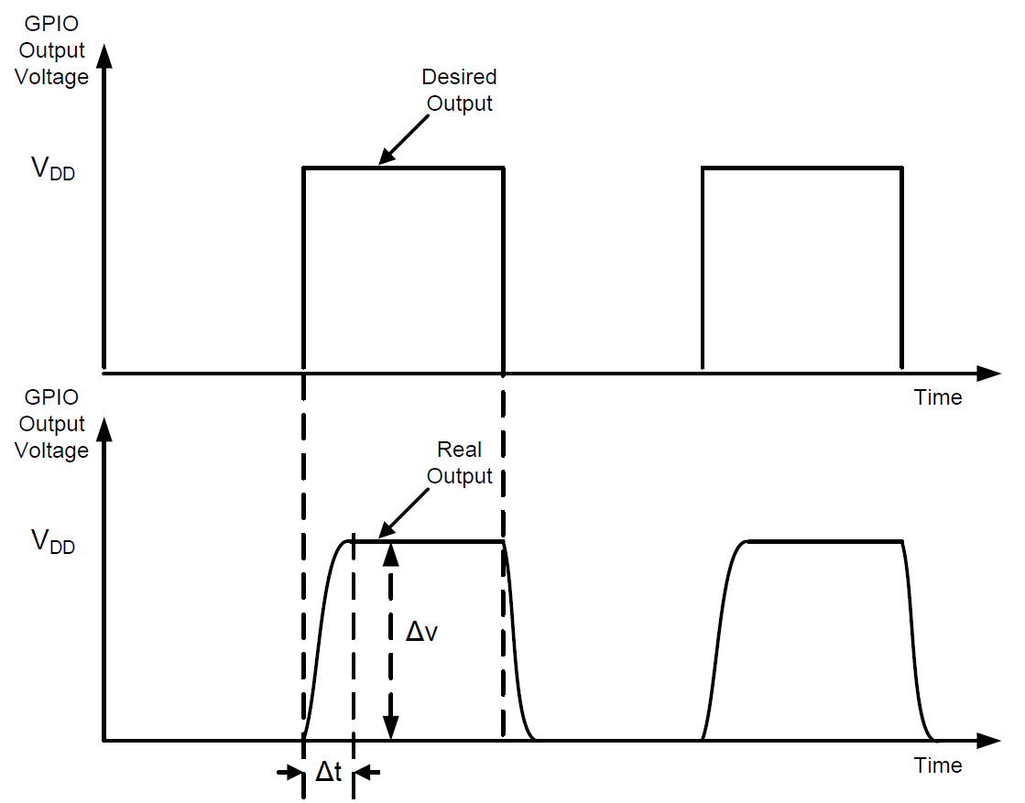
Slew Rate
Slew Rate:
Maximum rate of change of the output voltage
$$Slew Rate=max\left(\frac{∆V}{∆t}\right)$$
A high slew rate allows the output to be toggled at a fast speed.

Slide 50
GPIO Output: Push-Pull vs Open-Drain
Output Bit | Push-Pull | Open-Drain
1 | High | HiZ
0 | Low | Low
Use push-pull output, instead of open-drain output!
Notes:
{{Pause=2}} This table summarizes the difference between push pull, and open drain. Their difference is that, in the push-pull output, when the output data bit is one, the output pin has a high voltage. However, in the open-drain output, when the output data bit is one, the output pin is floating, or has high impedance. {{Pause=1}} In this example, we need to provide a high voltage on the output pin, in order to turn on the LED. Therefore, we have select the push-pull output, instead of the open-drain output.

Slide 51
GPIO Output Data Register (ODR)
16 bits reserved, 16 data bits, 1 bit for each pin
Pin 2
GPIOB->ODR |= 1UL << 2; // Set bit 2
Notes:
{{Pause=2}} The output data register is easy to understand. This register has the upper 16 bits reserved. It has 16 data bits, with one bit for each pin. Because the red LED is connected to pin 2, to turn on the LED, we need to set, bit 2, of the output data register, to 1.

Slide 52
Light up the Red LED (PB.2)
RCC->AHB2ENR |= RCC_AHB2ENR_GPIOBEN; // Enable clock of Port B
GPIOB->MODER &= ~(3UL<<4); // Clear mode bits
GPIOB->MODER |= 1UL<<4; // Set mode to output
GPIOB->OTYPE &= ~(1UL<<2); // Select push-pull output
GPIOB->ODR |= 1UL << 2; // Output 1 to turn on red LED
Notes:
{{Pause=2}} This slide summarizes the software code, which can turn on the red LED. The red LED is connected to pin 2 of port B. The software involves four steps. First, we turn on the clock to enable port B. Then, we set the mode of pin 2 of port B as digital output. Next, we select push-pull output, instead of open-drain output. Finally, we set, bit 2, of the output data register to light up the red LED.

Slide 53
GPIO Initialization
Turn on the clock to the GPIO Port (e.g. Port B)
RCC->AHBENR |= RCC_AHBENR_GPIOBEN; Reset and Clock Control (RCC)
Configure GPIO mode, output type, speed, pull-up/pull-down
typedef struct
{
__IO uint32_t MODER;
__IO uint16_t OTYPER;
uint16_t RESERVED0;
__IO uint32_t OSPEEDR;
__IO uint32_t PUPDR;
__IO uint16_t IDR;
uint16_t RESERVED1;
__IO uint16_t ODR;
uint16_t RESERVED2;
__IO uint16_t BSRRL; /* BSRR register is split to 2 * 16-bit fields BSRRL */
__IO uint16_t BSRRH; /* BSRR register is split to 2 * 16-bit fields BSRRH */
__IO uint32_t LCKR;
__IO uint32_t AFR[2];
} GPIO_TypeDef;
#define PERIPH_BASE ((uint32_t)0x40000000)
#define AHBPERIPH_BASE (PERIPH_BASE + 0x20000)
#define GPIOB_BASE (AHBPERIPH_BASE + 0x0400)
#define GPIOB ((GPIO_TypeDef *) GPIOB_BASE)

Slide 54
GPIO AFR:
The GPIO alternate function mode allows for each pin to perform a specialized task.
The tasks that can be performed vary from pin to pin, and include specific functions for various peripherals
The Alternate Function Register (AFR) is used to choose which Alternate Function each pin performs

Slide 55
STEVAL Board Features:
The STEVAL features an STM32F4 32-bit MCU with a variety of sensors and other peripherals
The sensors include a 3D accelerometer and gyroscope, a 3D magnetometer, and a MEMS pressure sensor
The STEVAL libraries use these sensors to allow for flight by adjusting the PWM output to the drone’s motors

Slide 56
The Lab:
Lab 1 will have you configure a timer on the STEVAL
Timer 4 will be configured to produce a PWM output
The drone uses this output to drive its rotors
The lab’s objective is to configure the timer and PWM output, then measure that output

Slide 57
The Lab: GPIOs
To complete this and future labs, you will need to configure GPIO (General Purpose Input/Output) pins
These pins are used by the STM32F4 to communicate with its peripherals and sensors
The GPIO registers, containing various settings, must be configured before the GPIOs can be used

Slide 58
Configuring Registers
The various registers used to configure the GPIOs, timers, and other components, can be difficult to correctly configure
The STM32F4’s reference manual should be used for the labs in this course, as it contains useful tables that show the mapping of every register
This document can be found in the course Drive

Slide 59
Configuring Registers in Code:
The following will explain how to configure registers through an example.
Assume that we want to set GPIO pin B6 to output mode:
First, we look in the reference manual to find the associated register, which happens to be the GPIOB_MODER register
The table shows that, to set pin B6 to output mode, we must set bits 13 and 12 to 0 and 1, respectively

Slide 60
Configuring Registers in Code:
To configure the register this way, we first do:
GPIOB->OTYPER &= ~(3<<(2*6));
This sets both bits 12 and 13 to zero, which ensures that the following command will work correctly
GPIOB->OTYPER |= 1<<(2*6);
This will set bit 12 to 1, and leave bit 13 set to 0
Performing operations this way prevents the bits we are not interested in from being modified
If the first line of code is not present, and bit 13 contains a 1 to begin with, that 1 will remain after the second line, causing an incorrect configuration

Slide 61
Things to do before Lab 1:
Before working on Lab 1, please install TrueStudio
The TrueStudio IDE will be used in all future labs
Also, please download the STEVAL project code
These resources can be found in the course Drive

